Slide 1



Control Structures
Topic 4
Selection

Slide 2

Objectives
To learn how to use the selection control structure.
To understand various selection structures.
To improve algorithm design skills.

Slide 3


3 Types Flow of Control
Sequential (we had learned in previous topic)
The statements in a program are executed in sequential order
Selection
allow the program to select one of multiple paths of execution.
The path is selected based on some conditional criteria (boolean expression).
Repetition (we will learn in next topic)

Slide 4
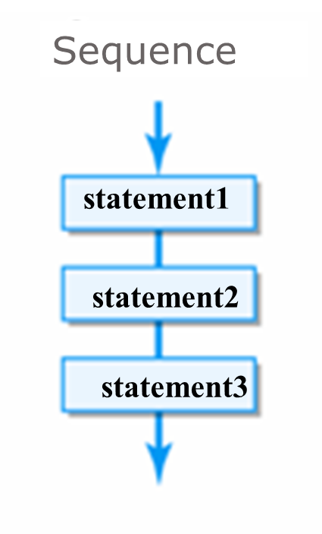
Flow of Control: Sequential Structures

Slide 5
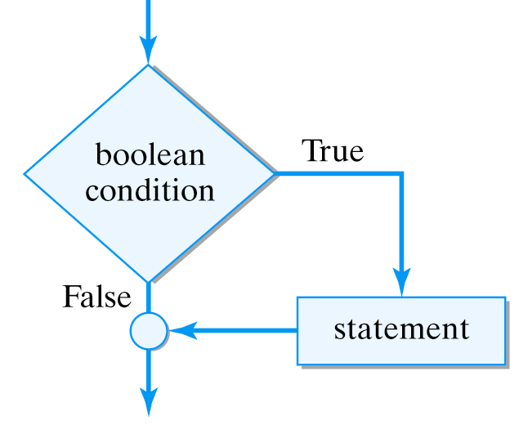
Flow of Control: Selection
If the Boolean expression evaluates to true, the statement will be executed. Otherwise, it will be skipped.

Slide 6

Example of Selection in Computer Program
MAX LOAD: 250 kg
Conditions
If exceed 250:
Give warning with
BEEP sound
If do not exceed 250:
Close the door and
go up/down
Actions

Slide 7
Flow of Control: Selection Structures
There are 3 types of Java selection structures:
if statement
if-else statement
switch statement

Slide 8
The if Statement
The if statement has the following syntax:
The condition must be a Boolean expression. It must evaluate to either true or false.
if is a Java reserved word
if ( condition )
statement;
If the condition is true, the statement is executed.
If it is false, the statement is skipped.

Slide 9
Boolean Expressions
A condition often uses one of Java's equality operators or relational operators, which all return Boolean results:
== equal to
!= not equal to
< less than
> greater than
<= less than or equal to
>= greater than or equal to

Slide 10
Examples of Boolean Expressions
Boolean Expressions | Descriptions
testScore < 80 | returns TRUE if testScore is less than 80
a == b | returns TRUE if a equals to b
numb1 != numb2 | returns TRUE if numb1 not equal to numb2
testScore * 2 > 350 | returns TRUE if testScore * 2 is greater than 350
w * (h*h) < 30 | returns TRUE if w*(h*h) is less than 30
a * a <=c | returns TRUE if a*a is less than or equal to c

Slide 11
Logic of an if statement
false
false
condition
evaluated
testScore < 40?
true
true
statement
System.out.println (“You failed”);
if (testScore<40) System.out.println(“You failed”);

Slide 12
The if Statement
The condition is evaluated first:
is testScore less than 40?
Executed when if statement is true, if no, it is skipped
double testScore = 38.5;
if (testScore < 40)
System.out.println("You failed");
System.out.println("Next semester will start on 2/9/2018");
Executed either if statement is true / false

Slide 13
Java code example: != operator
public class Count
{
public static void main (String args[])
{
double y=15.0;
double x=25.0;
if (y!=x)
System.out.println("Result : y not equal x");
}
}
Output:
Result : y not equal x

Slide 14
Java code example: >= operator
Java code example: >= operator
public class DeterminePrice
{
public static void main (String args[])
{
double totalPrice = 120;
if(totalPrice >= 100)
System.out.println("You will get 20% discount");
System.out.println("Thank you for coming to CMART");
}
}
Output:
You will get 20% discount
Thank you for coming to CMART

Slide 15
Java code example: <= operator
Java code example: <= operator
public class DetermineResult
{
public static void main (String args[])
{
double totalMarks = 60;
if(totalMarks <=40)
System.out.println("You failed the subject!");
System.out.println("Good luck for next sem");
}
}
Output:
Good luck for next sem

Slide 16



Think..
int number = 10;
if number == 10;
System.out.println("The number is" +number);
int number = 10;
if (number == 10)
System.out.println("The number is" +number);

Slide 17
Block Statements
Several statements can be grouped together into a block statement delimited by braces
if (testScore<40)
{
System.out.println ("You failed");
System.out.println ("Try harder next time");
}

Slide 18
Block Statements
if (testScore < 40)
{ System.out.println ("You failed");
System.out.println ("Try harder next time");
}
COMPARE WITH
if (testScore < 40)
System.out.println ("You failed");
System.out.println ("Try harder next time");

Slide 19
Logical (Boolean) Operation
Operators | Names | Descriptions
! | not | Returns TRUE when P is false and returns FALSE when P is true
&& | and | Returns TRUE only when both P and Q is true
|| | or | Returns TRUE when either P or Q is true
P, Q: conditions

Slide 20
Logical (Boolean) Operation
P, Q: conditions, e.g: if((carryMark<10) && (finalMark<20))
P
Q
P | Q | P&&Q | P||Q | !P
false | false | false | false | true
false | true | false | true | true
true | false | false | true | false
true | true | true | true | false

Slide 21
Logical Operators
Expressions that use logical operators can form complex conditions.
if ((ipuIndex < 100) && (distanceToClass < 2))
System.out.println ("Let’s walk to class");
if ((salary > expenses) || (savings > expenses))
System.out.println ("This guy have a lot of savings");
if (!(testScore <40))
System.out.println ("You passed the exam");

Slide 22
Precedence of Operators

Slide 23
The if-else Statement (2 way selection)
An else clause can be added to an if statement to make an if-else statement
if ( condition )
statement1;
else
statement2;
If the condition is true, statement1 is executed; if the condition is false, statement2 is executed
One or the other will be executed, but not both

Slide 24
Logic of an if-else statement
condition
evaluated
true
false
statement1
statement2

Slide 25
Logic of an if-else statement
true
testScore<40?
false
System.out.println(“You failed”);
System.out.println(“You passed”);

Slide 26
if/else Statement
if (testScore<40) System.out.println("You failed");
else System.out.println("You passed");
Purpose:
To execute a statement when a condition is true or false

Slide 27
DESIGN OF INTERACTIVE PROGRAM: PSEUDOCODE & FLOW CHART
Example of Algorithm: if/else Statement
Start
Input totalPrice
if(totalPrice > 100)
Calculate discount= 20.0/100 * totalPrice
else
Calculate discount = 5.0/100 * totalPrice
Print “Discount given is RM” +discount
End

Slide 28
SAMPLE CODE
import java.util.Scanner;
public class Discount
{
public static void main (String[] args)
{
double totalPrice, discount;
Scanner scan = new Scanner (System.in);
System.out.println ("Enter total price:");
totalPrice = scan.nextDouble();
if(totalPrice > 100)
discount = 20.0 / 100 * totalPrice;
else
discount = 5.0 / 100 * totalPrice;
System.out.printf("Discount given is RM %.2f“,discount);
}
}

Slide 29
Output
Sample Run
Enter total price:
90
Discount given is RM 4.50

Slide 30
Block Statement
if (testScore<40)
{ System.out.println ("You failed");
System.out.println ("Try harder next time");
}
else
{
System.out.println ("You passed");
System.out.println ("Keep it up!");
}

Slide 31
Flow chart for if else statement: with block
Start
Input testScore
true
testScore<40?
false
Print “You failed”
Print “Try harder”
Print “You passed”
Print “Keep it up!”
End

Slide 32
Pseudo code for if else statement: with block
Start
Input testScore
if (testScore<40)
Print "You failed"
Print "Try harder"
else
Print "You passed"
Print "Keep it up!"
End

Slide 33
Combination of Block Statement and Logical Operators
EXAMPLE:
Determine Grade, if testScore is higher or equal to 85%, the achieved grade is A
if ((testScore >=85) && (testScore<=100 ))
{ System.out.println("Congrats! Your grade is A.");
System.out.println("Keep it up!");
}
else
{
System.out.println("Sorry, you did not get A.");
System.out.println("Try again next time.");
}

Slide 34
Multiple Selection
Syntax:
if (expression1)
statement1
else if (expression2)
statement2
else
statement3
Notes:
Else is associated with the most recent incomplete if.
Multiple if statements can be used in place of if…else statements.
May take longer to evaluate.

Slide 35
Flow chart for Multiple Selection
Start
Input testScore
true
testScore>90?
Print “Very high grade”
Print “Keep it up!”
false
testScore>50
&& testScore<60?
true
Print “Moderate”
Print “Can improve”
false
Print “Not very high or moderate”
End

Slide 36
Multiple Selection
if (testScore>90)
{ System.out.println ("Very high grade");
System.out.println ("Keep it up!");
}
else if (testScore>50 && testScore <60)
{
System.out.println ("Moderate");
System.out.println ("Can improve");
}
else
{
System.out.println ("Not very high or moderate");
}

Slide 37
Java code (multiple selection)
int a;
System.out.println("Enter the number:");
a = scan.nextInt();
if (a>=1)
{
System.out.println ("The number you entered is :" + a);
System.out.println ("You entered a positive number");
}
else if (a<0)
{
System.out.println ("The number you entered is :" + a);
System.out.println ("You entered a negative number");
}
else
{
System.out.println ("The number you entered is :" + a);
System.out.println ("You entered zero");
}
Notes:
Utk aturcara lengkap, sila rujuk h/out (java code no 4)

Slide 38
Sample Run
Output1
Enter the number : 15
The number you entered is :15
You entered a positive number
Output2
Enter the number : -15
The number you entered is :-15
You entered a negative number
Output3
Enter the number : 0
The number you entered is :0
You entered zero

Slide 39
Multiple Selections
Example
The grading scheme for a course is given as below:
Mark Grade
90 - 100 A
80 – 89 B
70 – 79 C
60 – 69 D
0 - 59 F
Read a mark & determine the grade.

Slide 40
Multiple Selections
if ((mark >= 90) && (mark <=100))
grade = ‘A’;
else if ((mark >= 80) && (mark <= 89))
grade = ‘B’;
else if ((mark >= 70) && (mark <= 79))
grade = ‘C’;
else if ((mark >= 60) && (mark <= 69))
grade = ‘D’;
else
grade = ‘F’;

Slide 41
Multiple Selections
if (mark >= 90)
grade = ‘A’;
else if (mark >= 80)
grade = ‘B’;
else if (mark >= 70)
grade = ‘C’;
else if (mark >= 60)
grade = ‘D’;
else
grade = ‘F’;
if ((mark >= 90) && (mark <=100))
grade = ‘A’;
if ((mark >= 80) && (mark <= 89))
grade = ‘B’;
if ((mark >= 70) && (mark <= 79))
grade = ‘C’;
if ((mark >= 60) && (mark <= 69))
grade = ‘D’;
if ((mark >= 0) && (mark <= 59))
grade = ‘F’;
Equivalent code with series of if statements

Slide 42
Exercise
Write a program that asks an integer number from user as input.
The program will determine the type of entered number, whether it is an odd or even number.
Then it will display the type of the number.
Sample run:
Enter an integer number:35 The number is odd
Enter an integer number:20 The number is even

Slide 43
Multiple Selection (Nested if)
public class TestNestedIf {
public static void main(String args[]) {
int a = 50; int b = 10;
if( a == 50 ) {
if( b <= 10 ) {
System.out.print("a = 50 and b <= 10");
}
}
}//main
} //class

Slide 44
Multiple Selection (Nested if)
Example
int numb = 50; if(numb%2 == 0) { if(numb >0)
{ System.out.println("The even number is a positive number"); } }
else
{ System.out.println("The number is odd"); }

Slide 45
Multiple Selection (Nested if)
double balance = 90.00, penalty=10.00; int interestRate = 2; if(balance>=50.00) { if(interestRate>=0) balance = balance + ((interestRate * balance)/12); else System.out.println("Cannot have negative interest"); } else balance = balance - penalty; System.out.println("The balance is "+balance);
The balance is 105.0

Slide 46

TODAY’S TAKE AWAY
Selection control structure.
Various selection structures.

